Slide 1
Foundational Knowledge for AI
Fredrik Heintz
Dept. of Computer Science Linköping University
fredrik.heintz@liu.se
@FredrikHeintz
Outline:
Uninformed Search Algorithms
Informed Search Algorithms
Search in Complex Environments
Adversarial Search and Games

Slide 2
Algorithmic, Knowledge-Based and Learning-Based AI
2
AI-program written by programmers
Knowledge added by domain experts
Training data added by domain experts
General solver written by programmers
General learning system written by programmers
Computer
Computer
Computer
Algorithmic
Knowledge-based
Learning-based
(Pattern-based)
TDDC17 - HT23 - Fredrik Heintz - LE2 Search I (based on slides by Patrick Doherty)

Slide 3
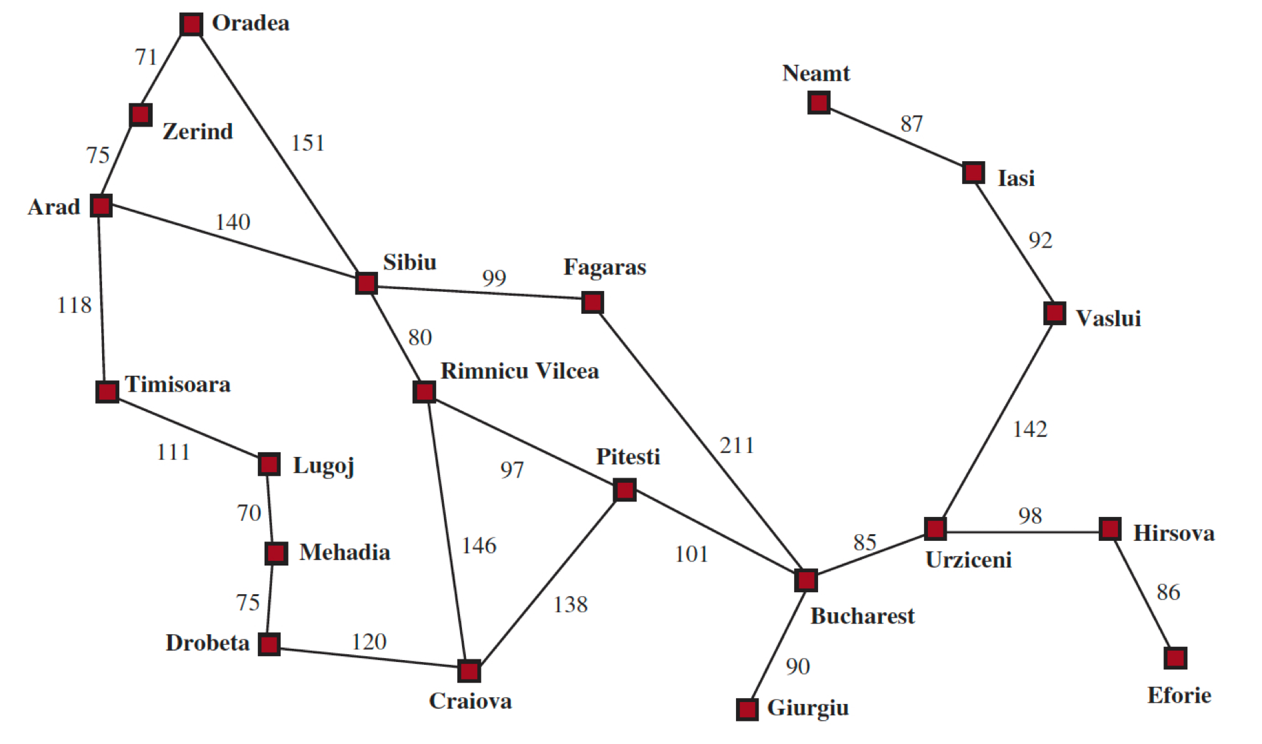
Romania Route Finding Problem

Slide 4
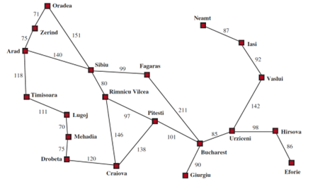
Problem Formulation
State Space - A set of possible states that the environment can be in
Cities in the Romania map.
Initial State - The state the agent starts in
Arad
ACTIONS(State) - A description of what actions are applicable in each state.
ACTIONS(Arad)= {ToSibiu, ToTimisoara, ToZerind}
RESULT(State, Action) - A description of what each action does (Transition Model)
RESULT(Arad, ToZerind)= Zerind
Goal Test - Tests whether a given state is a goal
Often a set of states: { Bucharest }
An Action Cost Function - denoted ACTION-COST(s,a,s’) when programming, or c(s,a,s’) when doing math.
Gives the numeric cost of doing a in s to reach state s’.
Cost functions should reflect the agents performance measure: distance, time taken, etc.
Solution - A path from the start state to the goal state

Slide 5
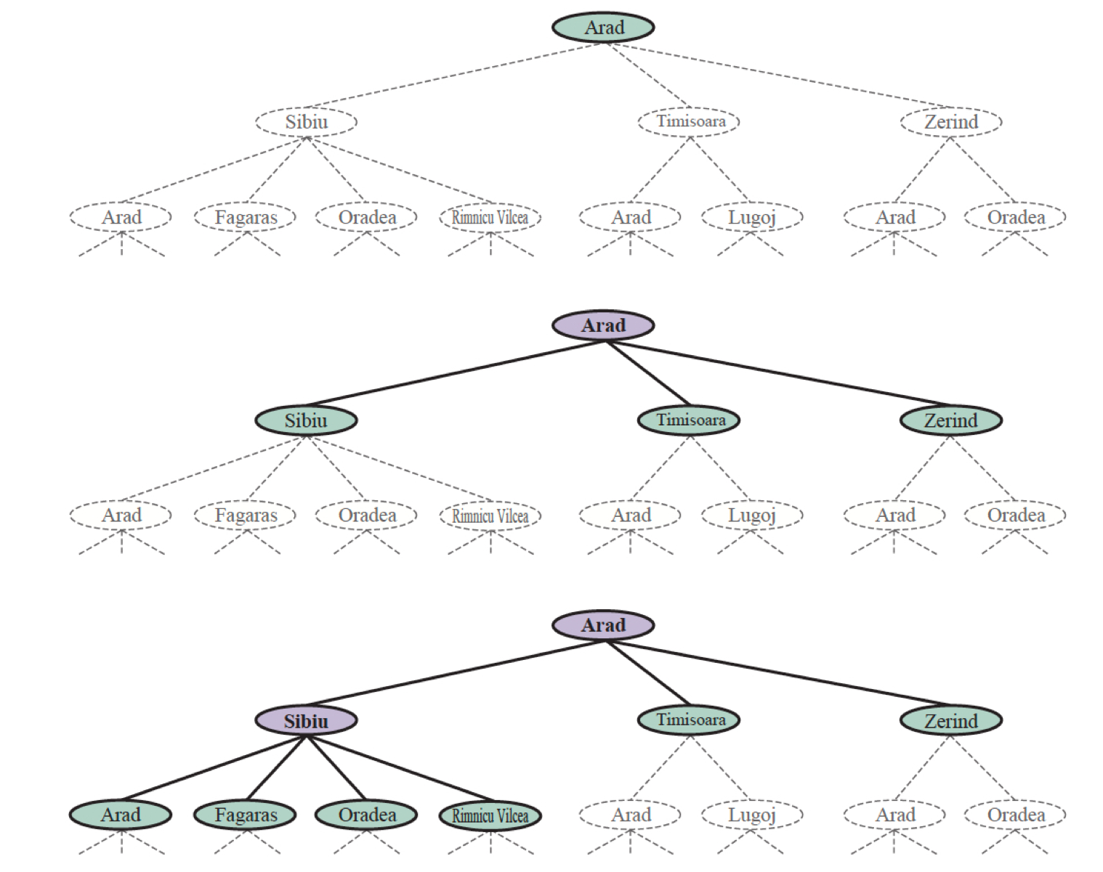

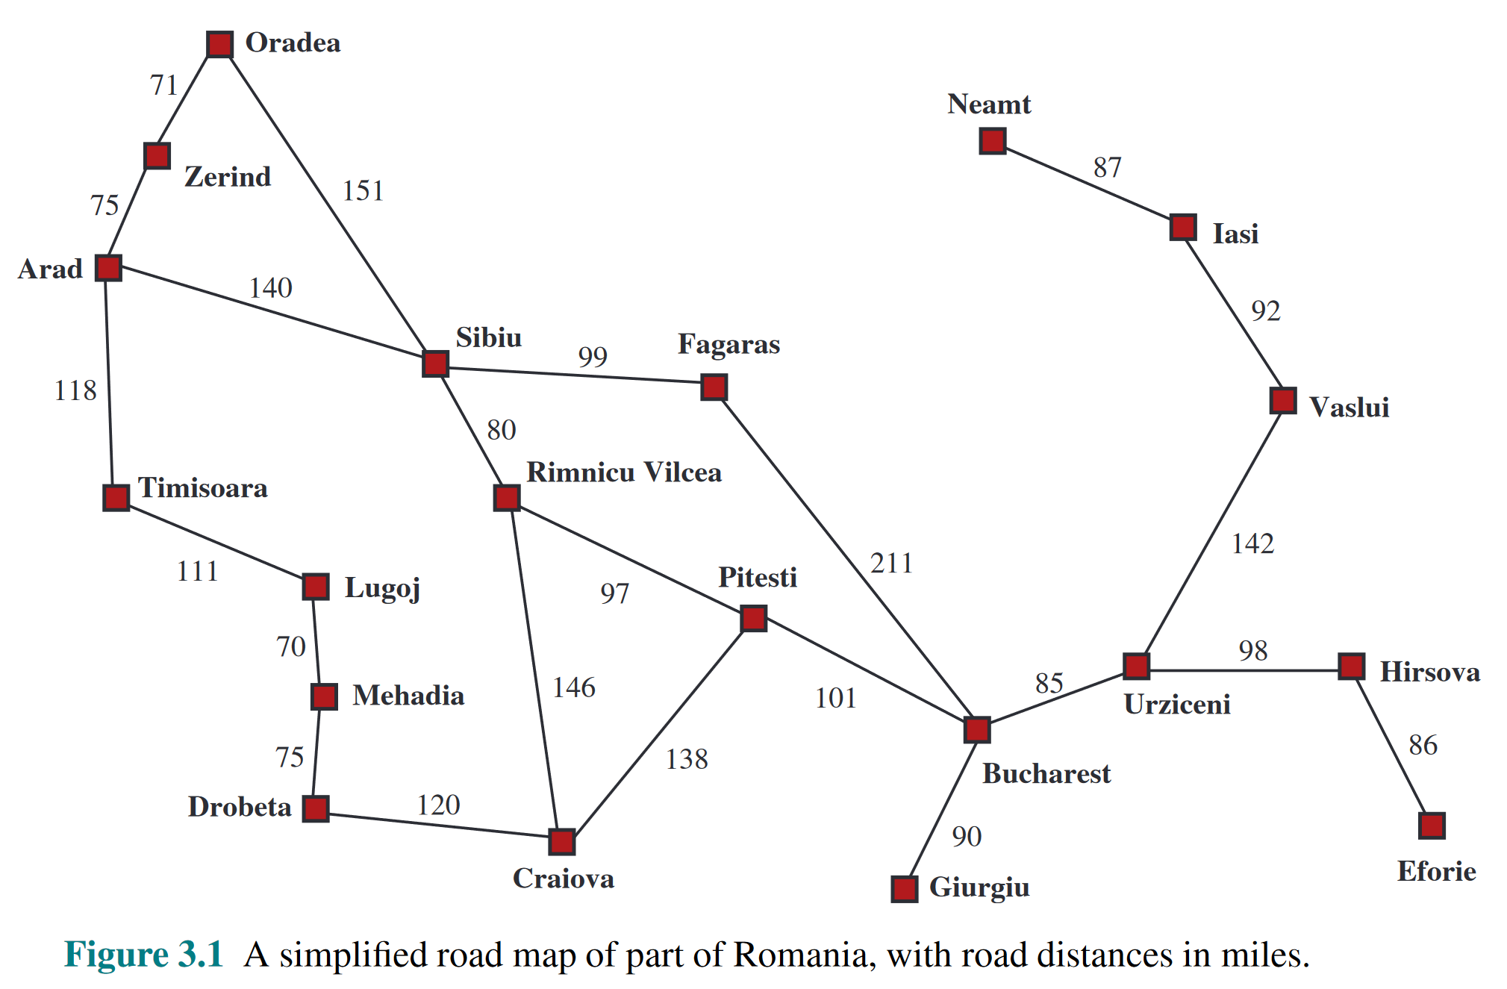
3 Partial Search Trees: Route Finding
2023-08-31
5
Initial state
After expanding Arad
Expanded
Generated
Not Expanded
After expanding Sibiu

Slide 6
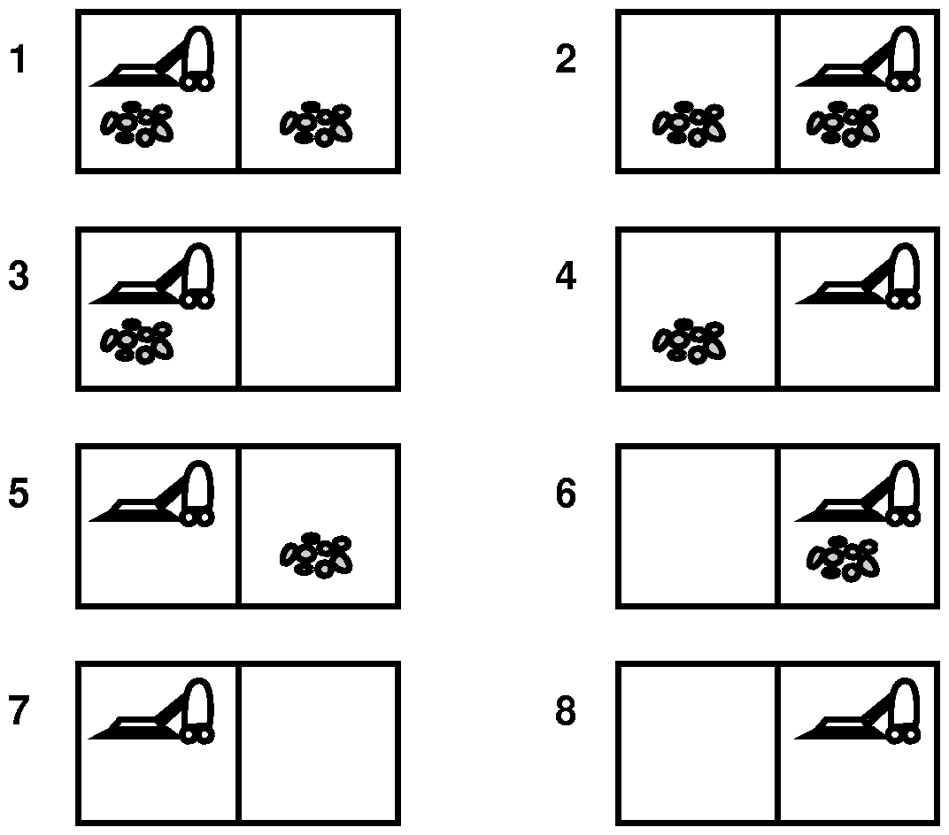
Problem Formulation: Vacuum cleaning world
2023-08-31
6
State Space:
2 positions, dirt or no dirt -> 8 world states
Actions:
Left (L), Right (R), or Suck (S)
Transition model: next slide
Initial State: Choose.
Goal States:
States with no dirt in the rooms
Action costs:
one unit per action

Slide 7
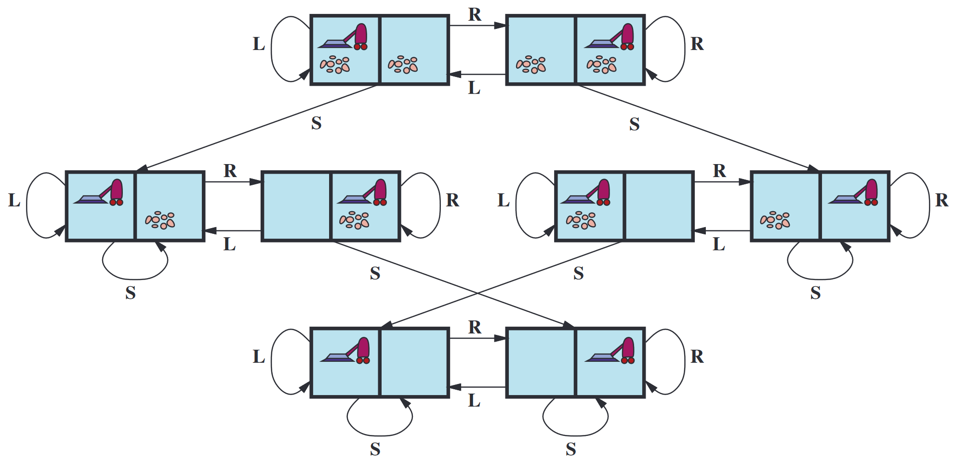
Solving the Vacuum World

Slide 8
Problem Formulation: Missionaries and Cannibals
Informal problem description:
Three missionaries and three cannibals are on one side of a river that they wish to cross.
A boat is available that can hold at most two people.
You must never leave a group of missionaries outnumbered by cannibals on the same bank.
How should the state space be represented?
What is the initial state?
What is the goal state?
What are the actions?

Slide 9
One Formalization
Many other formalisations
State Space: triple (x,y,z) with 0 ≤ x,y,z ≤ 3, where x,y, and z represent the number of missionaries, cannibals and boats currently on the original bank.
Initial State: (3,3,1)
Actions: see transition model
Transition Model: from each state, either bring one missionary, one cannibal, two missionaries, two cannibals, or one of each type to the other bank.
Note: not all states are attainable (e.g., (0,0,1)), and some are illegal.
Goal States: {(0,0,0)}
Action Costs: 1 unit per crossing

Slide 10
General Search
From the initial state, produce all successive states step by step —> search tree.
M, C, B
(a) initial state
(3,3,1)
(b) after expansion
(3,3,1)
of (3,3,1)
(2,3,0)
(3,2,0)
(2,2,0)
(1,3,0)
(3,1,0)
(c) after expansion
(3,3,1)
of (3,2,0)
(2,3,0)
(3,2,0)
(2,2,0)
(1,3,0)
(3,1,0)
(3,3,1)

Slide 11
Examples of Real-World Problems
Route Planning, Shortest Path Problem
Routing video streams in computer networks, airline travel planning, military operations planning...
Travelling Salesperson Problem (TSP)
A common prototype for NP-complete problems
VLSI (integrated circuits) Layout
Another NP-complete problem
Robot Navigation (with high degrees of freedom)
Difficulty increases quickly with the number of degrees of freedom. Further possible complications: errors of perception, unknown environments
Assembly Sequencing
Planning of the assembly of complex objects (by robots)

Slide 12

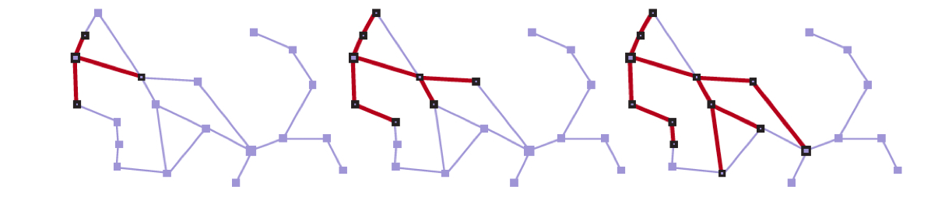

Search Algorithms
We focus on algorithms that superimpose a search tree over the state space graph
Important distinction between search tree and state space!
Search tree Construction
State Space Graph
Expanded
Generated
Not Expanded
Graph-Search: Only add a child if the state associated with it
has not already been reached:
Avoid cycles
Avoid redundant paths
Frontier (choose from here)
Oradea: has 2 successor states, but already reached
by other paths, so do not expand.
Oradea
Sequence of search trees superimposed
(each node only has one parent)

Slide 13
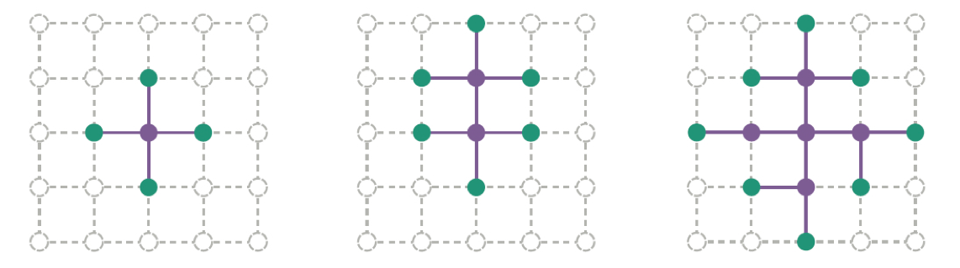
Search Algorithms
Separation property of graph search
The frontier (green) separates the interior (lavender) form the exterior (faint dashed)
Any state with a node generated for it is said to be reached
What is the best way to search through a state space in a systematic
manner in order to reach a goal state?

Slide 14
Search Strategies
A strategy is defined by picking the order of node expansion.
Strategies can be evaluated along the following dimensions:
Completeness – does it find a solution if it exists?
Time Complexity – number of nodes generated/expanded
Space Complexity – maximum number of nodes in memory
Optimality – does it always find a least cost solution
Time and space complexity are measured in terms of:
b – maximum branching factor of search tree
d – depth of the least cost solution in the search tree
m – maximum length of any path in the state space (possibly infinite)

Slide 15
Some Search Classes
Uninformed Search (Blind Search)
No additional information about states besides that in the problem definition
Can only generate successors and compare against state.
Some examples:
Breadth-first search, Depth-first search, Iterative deepening DFS
Informed Search (Heuristic Search)
Strategies have additional information as to whether non-goal states are more promising than others.
Some examples:
Greedy Best-First Search, A* Search

Slide 16
Implementing the Search Tree
Data structure for nodes in the search tree:
STATE: state in the state space
PARENT: Predecessor nodes
ACTION: The operator that generated the node
DEPTH: number of steps along the path from the initial state
PATH-COST: Cost of the path from the initial state to the node
Operations on a queue/frontier (4th Edition):
IS-EMPTY(frontier): Empty test
POP(frontier): Returns the first element of the queue
TOP(frontier): Returns the first element
ADD(node, frontier): Inserts new elements into the queue
Operations on a queue (3rd Edition):
Make-Queue(Elements): Creates a queue
Empty?(Queue): Empty test
First(Queue): Returns the first element of the queue
Remove-First(Queue): Returns the first element
Insert(Element, Queue): Inserts new elements into the queue
(various possibilities)
Insert-All(Elements, Queue): Inserts a set of elements into the queue
Three kinds of Queues:
Priority Queue - min cost first
FIFO Queue - first in, first out
LIFO Queue - last in, first out

Slide 17
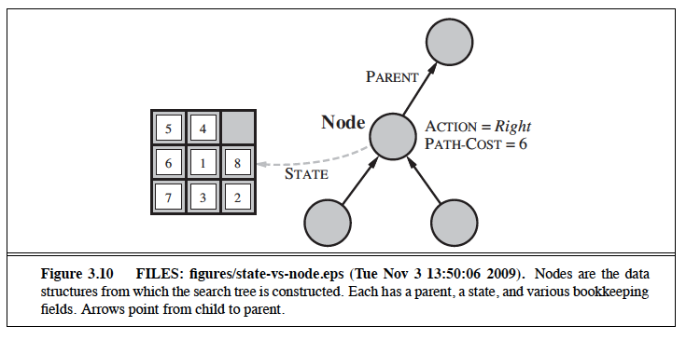
States (in state space) and Nodes (in a search tree)
17
PATH-COST - Total cost of the path
from initial state to this node
node.STATE
node.PARENT
node.ACTION
node.PATH-COST
Can have a finite set of states in state space, but sometimes
infinite nodes in a search tree (when loops are allowed)
Can have several nodes with the same state due to multiple paths to the state
The search tree describes paths between states leading towards a goal

Slide 18
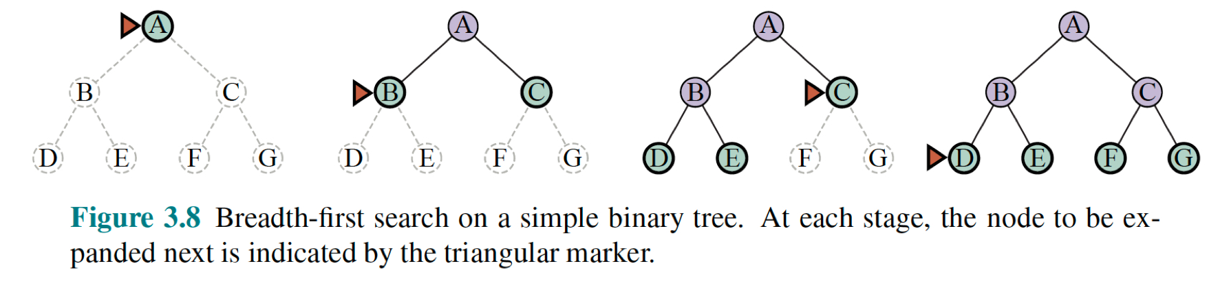
Breadth-First Search
Assume all actions have the same cost
Search by Minimal Depth:
Could be implemented using Best-First-Search:
BREADTH-FIRST-SEARCH
DEPTH )
f(n) = n.DEPTH
Is a better way!

Slide 19
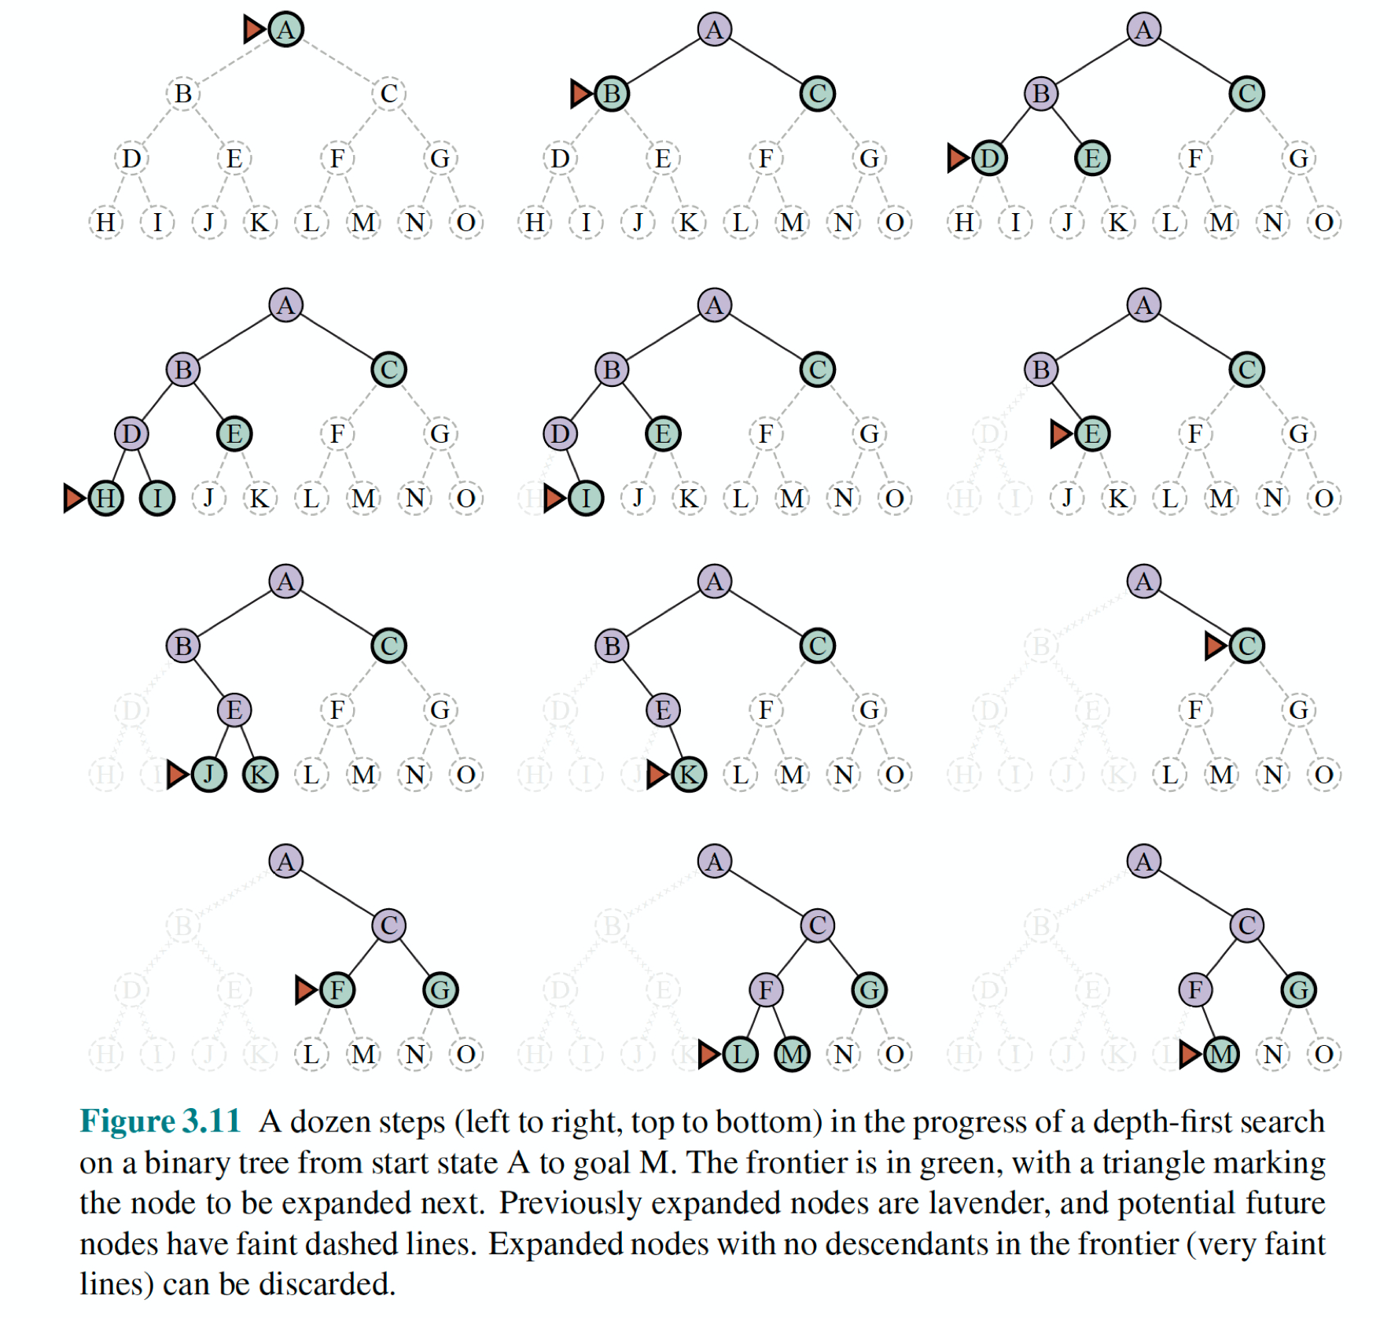
Depth-First Search
Assume all actions have the same cost
Always expands
deepest node
in the frontier first
Usually implemented not as
graph search but as
tree-like search (without a
table of reached states)

Slide 20
Heuristic Search

Slide 21
Intuitions behind Heuristic Search
2023-09-04
Separation property of graph search
Systematic Search
through the state space
Find a heuristic measure h(n) which estimates how close
a node n in the frontier is to the nearest goal state and
then order the frontier queue accordingly relative to closeness.
The evaluation function f(n), previously discussed will include h(n):
f(n) = .... + h(n)
h(n) is intended to provide domain
specific hints about location of goals

Slide 22
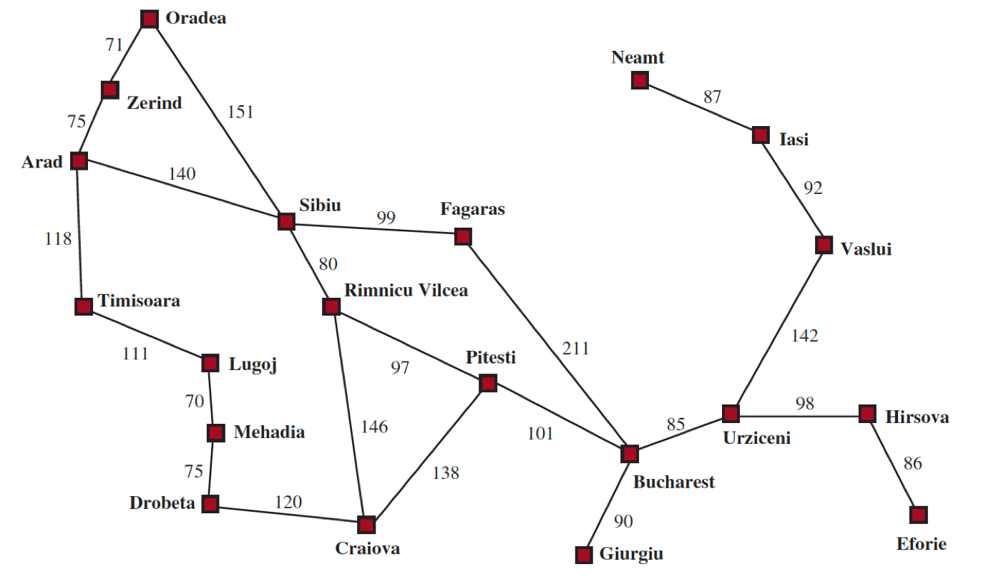
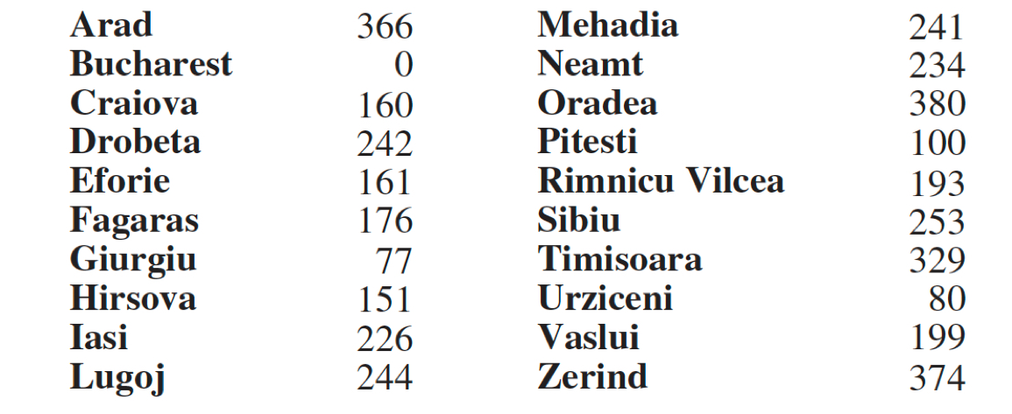
Romania Travel Problem
Let’s find a heuristic!
Straight line distance from city n to goal city n’
Assume the cost to get somewhere is a function of the distance traveled
Straight line distance to
Bucharest from any city
hSLD()
Heuristic:
f(n) = hSLD(n)
Notice the SLD under estimates the actual cost!

Slide 23

Greedy Best-First Search: Romania
2023-09-04
1
Arad[366]
goto(Sibiu)
Zerind[374]
Timisoara[329]
Sibiu[253]
2
goto(Fagaras)
Straight line distance to
Bucharest from any city
hSLD()
Oradea[380]
Riminicu
Vilcea[193]
Fagaras[176]
3
goto(Bucharest)
Bucharest[0]

Slide 24

A*-1
A* Tree-like Search
g(Arad)+h(Arad)
Heuristic (with Bucharest as goal):
f(n) = g(n) + h(n)
g(n) - Actual distance from root node to n
h(n) - hSLD(n) straight line distance from n to Bucharest
g(n)
Straight line distance to
Bucharest from any city
h(n) = hSLD(n)

Slide 25
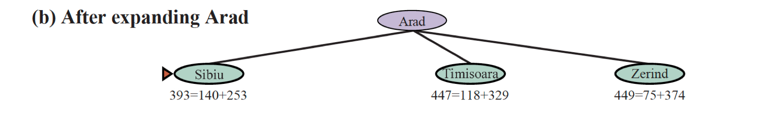
A*-2
A* Tree-like Search
g(n)
Straight line distance to
Bucharest from any city
h(n) = hSLD(n)

Slide 26
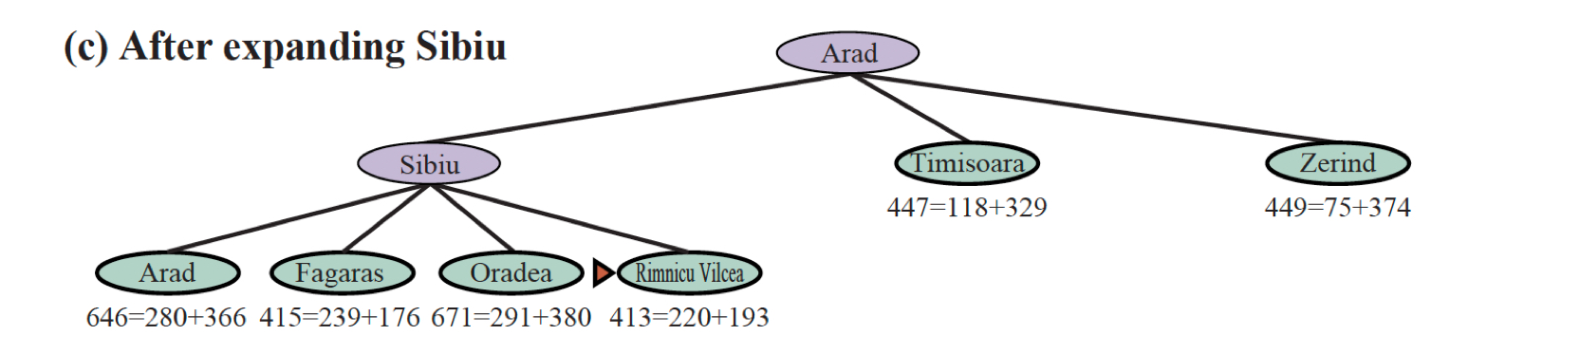
A*-3
A* Tree-like Search
g(n)
Straight line distance to
Bucharest from any city
h(n) = hSLD(n)

Slide 27
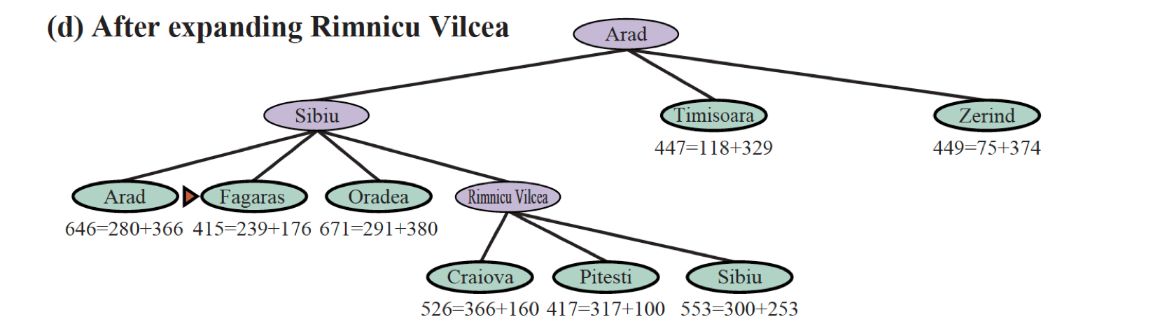
A*-4
A* Tree-like Search
g(n)
Straight line distance to
Bucharest from any city
h(n) = hSLD(n)

Slide 28
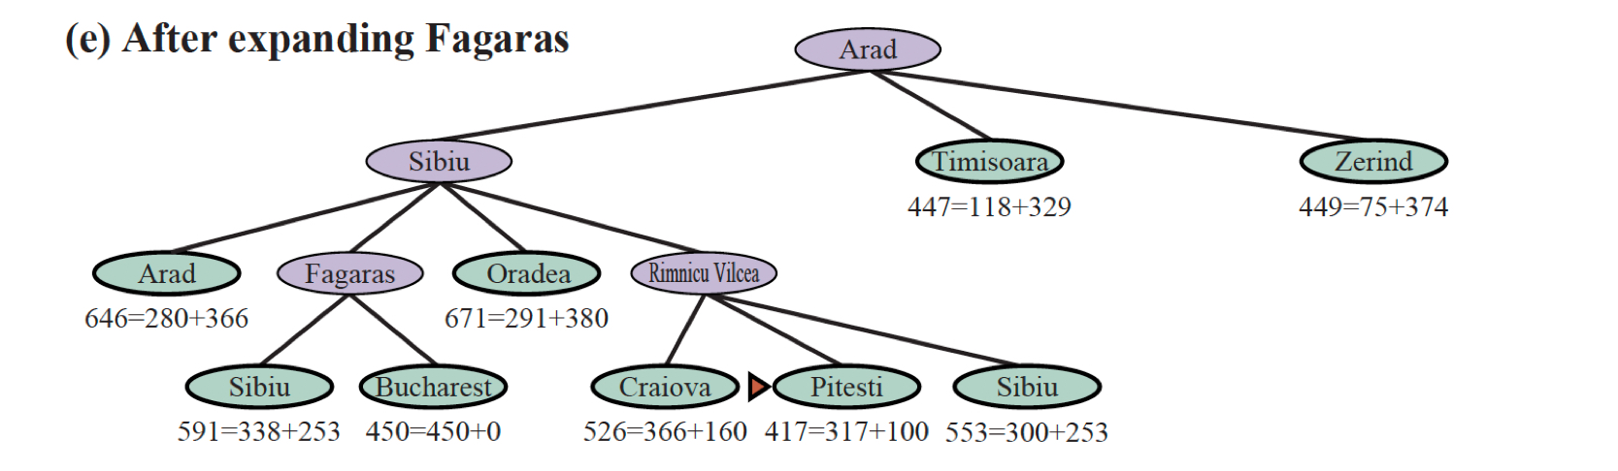
A*-4
A* Tree-like Search
g(n)
Straight line distance to
Bucharest from any city
h(n) = hSLD(n)

Slide 29
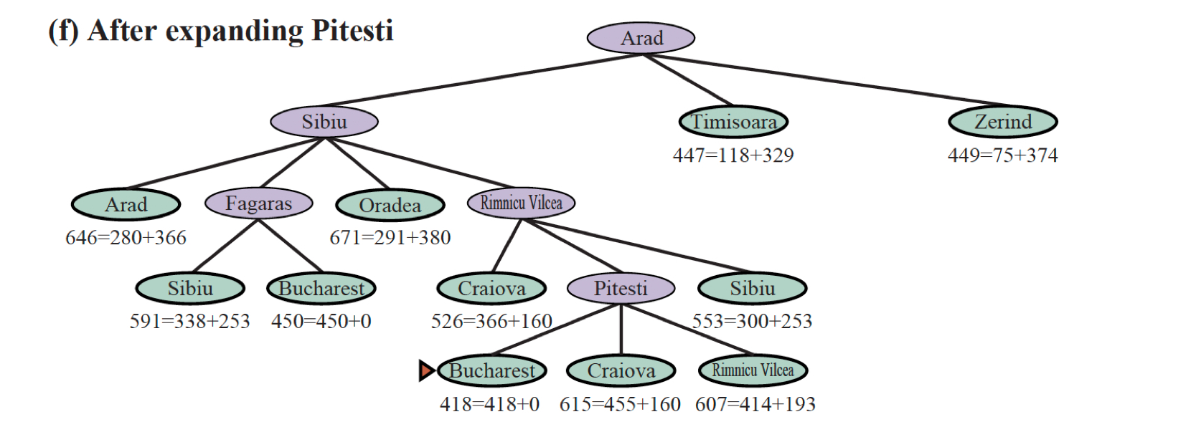
A*-6
A* Tree-like Search
Place in frontier Expand
Late Testing Goal
g(n)
Straight line distance to
Bucharest from any city
h(n) = hSLD(n)

Slide 30
Some properties of A*
Cost-Optimal -
for a given admissible heuristic (tree-like search)
for a given consistent heuristic (tree-like, graph-search)
Consistent heuristics are admissible heuristics but not vice-versa.
Complete - Eventually reach a contour equal to the path of the least-cost to the goal state.
Optimally efficient - No other algorithm, that extends search paths from a root is guaranteed to expand fewer nodes than A* for a given heuristic function.
The exponential growth for most practical heuristics will eventually overtake the computer (run out of memory)
The number of states within the goal contour is still exponential in the length of the solution.
There are variations of A* that bound memory....

Slide 31

Search in Complex Environments

Slide 32
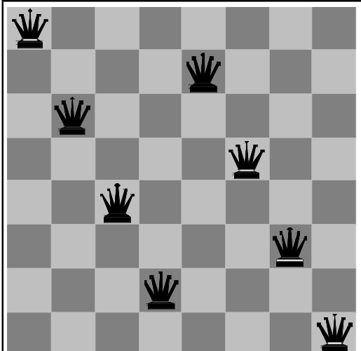
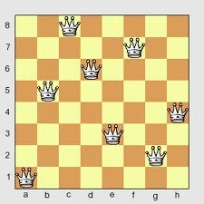
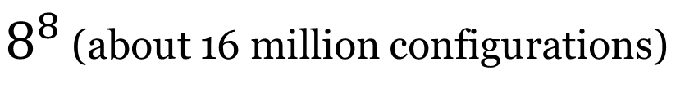
Local Search: 8 Queens Problem
Problem:
Place 8 queens on a chessboard such that
No queens attacks another
Local Search:
the path to the goal is irrelevant!
we do not care about reached states
complete state formulation is a straightforward representation:
8 queens, one in each column
operate by searching from start state to neighbouring states, choose the best neighbour so far, repeat
Bad Solution
8 Queens is a candidate for use of local search!
$8^{8}$ (about 16 million configurations)
Good Solution

Slide 33
Local Search Techniques
Advantages:
They use very little memory
Often find solutions in large/infinite search spaces where systematic algorithms would be unreasonable
Can be used to solve optimisation problems
Disadvantages
Since they are not systematic they may not find solutions because they leave parts of the search space unexplored.
Performance is dependent on the topology of the search space
Search may get stuck in local optima
Global Optimum: The best possible solution to a problem.
Local Optimum: A solution to a problem that is better than all other solutions that are slightly different, but worse than the global optimum
Greedy Local Search: A search algorithm that always takes the best immediate, or local, solution while finding an answer. Greedy algorithms find the overall, or globally optimal solution for some optimization problems, but may find less-than-optimal solutions for some instances of other problems. (They may also get stuck!)

Slide 34
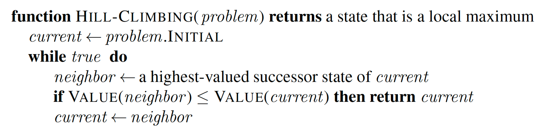
Hill-Climbing Algorithm (steepest ascent version)
When using heuristic functions: steepest descent version

Slide 35
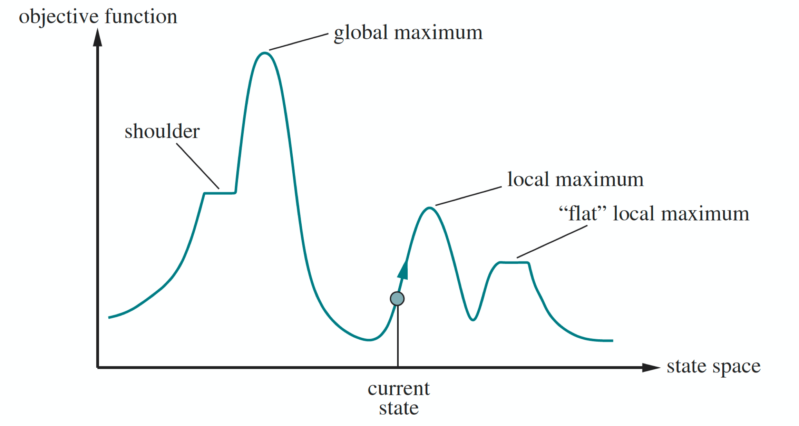
Greedy Progress: Hill Climbing
Aim: Find the global maximum
One dimensional
state space
landscape
Hill Climbing: Modify the current state to try and improve it

Slide 36
Variations on Hill Climbing
Stochastic Hill Climbing
Choose among uphill moves at random, weighting choice by probability with the steepness of the move
First Choice Hill Climbing
Implements stochastic hill climbing by randomly generating successors until one is generated that is better than the current state.
Random-Restart Hill Climbing
Conducts a series of hill-climbing searches from randomly generated initial states until a goal is found.

Slide 37
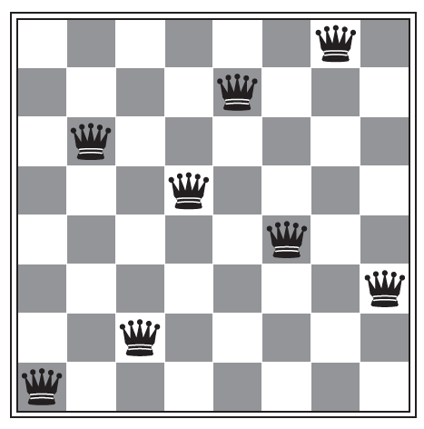
Local Beam Search
2023-09-04
Start with k
random states
. . .
. . .
Determine
successors
of all k
random states
If any successors are goal states
then finished
Else select k
best states from
union of successors and repeat
. . .
Can suffer from lack of diversity among the k states (concentrated in small region of search space).
Stochastic variant: choose k successors at random with probability of choosing the successor being an increasing function of its value.

Slide 38
Simulated Annealing
2023-09-04
Hill Climbing + Random Walk
Escape local maxima by allowing “bad” moves (random)
Idea: but gradually decrease their size and frequency
Origin of concept: metallurgical annealing
Bouncing ball analogy (gradient descent):
Shaking hard (= high temperature)
Shaking less (= lower the temperature)
If Temp decreases slowly enough, best state is reached

Slide 39
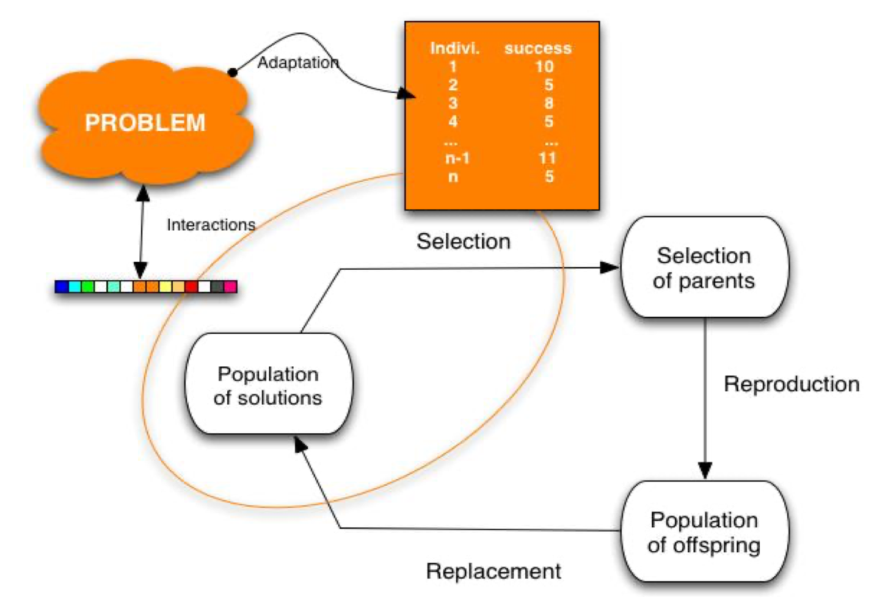
Evolutionary Algorithms
Variants of Stochastic Beam Search using the
metaphor of natural selection in biology
Often used for difficult
non-linear optimisation
problems

Slide 40
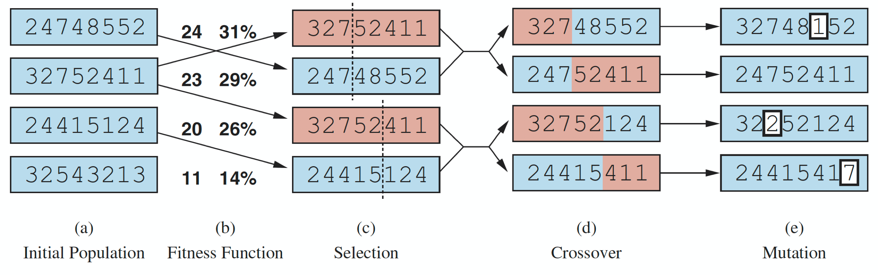
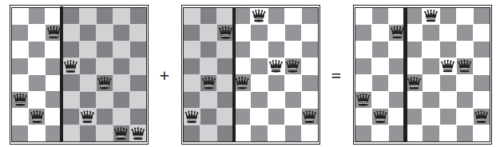
Genetic Algorithms
Non-attacking
pairs of queens
board
encodings
probability of choosing proportional to fitness
select pairs randomly
for reproduction
choose crossover
point randomly
random mutation
small prob.
3 2 7 4 8 5 4 2
crossover: breed offspring in next generation
3 2 7 5 2 4 1 1
2 4 7 4 8 5 4 2

Slide 41
Adversarial Search

Slide 42
Why Study Board Games?
Board games are one of the oldest branches of AI (Shannon and Turing 1950).
Board games present a very abstract and pure form of competition between two opponents and clearly require a form of “intelligence”.
The states of a game are easy to represent
The possible actions of the players are well-defined
Realization of the game as a search problem
It is nonetheless a contingency problem, because the characteristics of the opponent are not known in advance

Slide 43
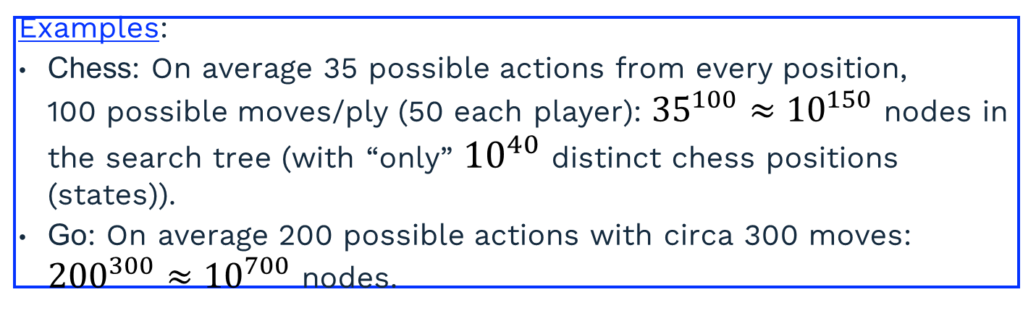
Challenges
Board games are not only difficult because they are contingency problems, but also because the search trees can become astronomically large.
Examples:
Chess: On average 35 possible actions from every position, 100 possible moves/ply (50 each player): ${35}^{100}≈{10}^{150}$ nodes in the search tree (with “only” ${10}^{40}$ distinct chess positions (states)).
Go: On average 200 possible actions with circa 300 moves: ${200}^{300}≈{10}^{700}$ nodes.
Good game programs have the properties that they
delete irrelevant branches of the game tree,
use good evaluation functions for in-between states, and
look ahead as many moves as possible.

Slide 44
More generally: Adverserial Search
Multi-Agent Environments
agents must consider the actions of other agents and how these agents affect or constrain their own actions.
environments can be cooperative or competitive.
One can view this interaction as a “game” and if the agents are competitive, their search strategies may be viewed as “adversarial”.
Most often studied: Two-agent, zero-sum games of perfect information
Each player has a complete and perfect model of the environment and of its own and other agents actions and effects
Each player moves until one wins and the other loses, or there is a draw.
The utility values at the end of the game are always equal and opposite, thus the name zero-sum.
Chess, checkers, Go, Backgammon (uncertainty)

Slide 45
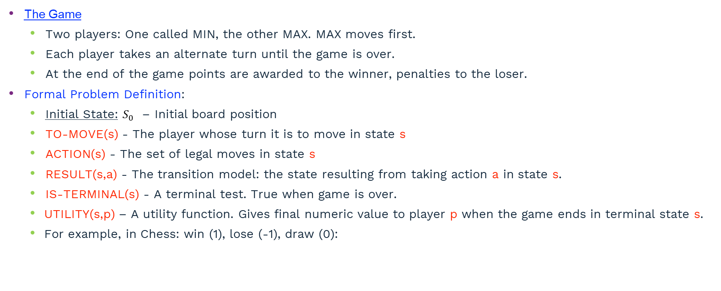
Games as Search
2023-09-04
The Game
Two players: One called MIN, the other MAX. MAX moves first.
Each player takes an alternate turn until the game is over.
At the end of the game points are awarded to the winner, penalties to the loser.
Formal Problem Definition:
Initial State: $S_{0}$ – Initial board position
TO-MOVE(s) - The player whose turn it is to move in state s
ACTION(s) - The set of legal moves in state s
RESULT(s,a) - The transition model: the state resulting from taking action a in state s.
IS-TERMINAL(s) - A terminal test. True when game is over.
UTILITY(s,p) – A utility function. Gives final numeric value to player p when the game ends in terminal state s.
For example, in Chess: win (1), lose (-1), draw (0):

Slide 46
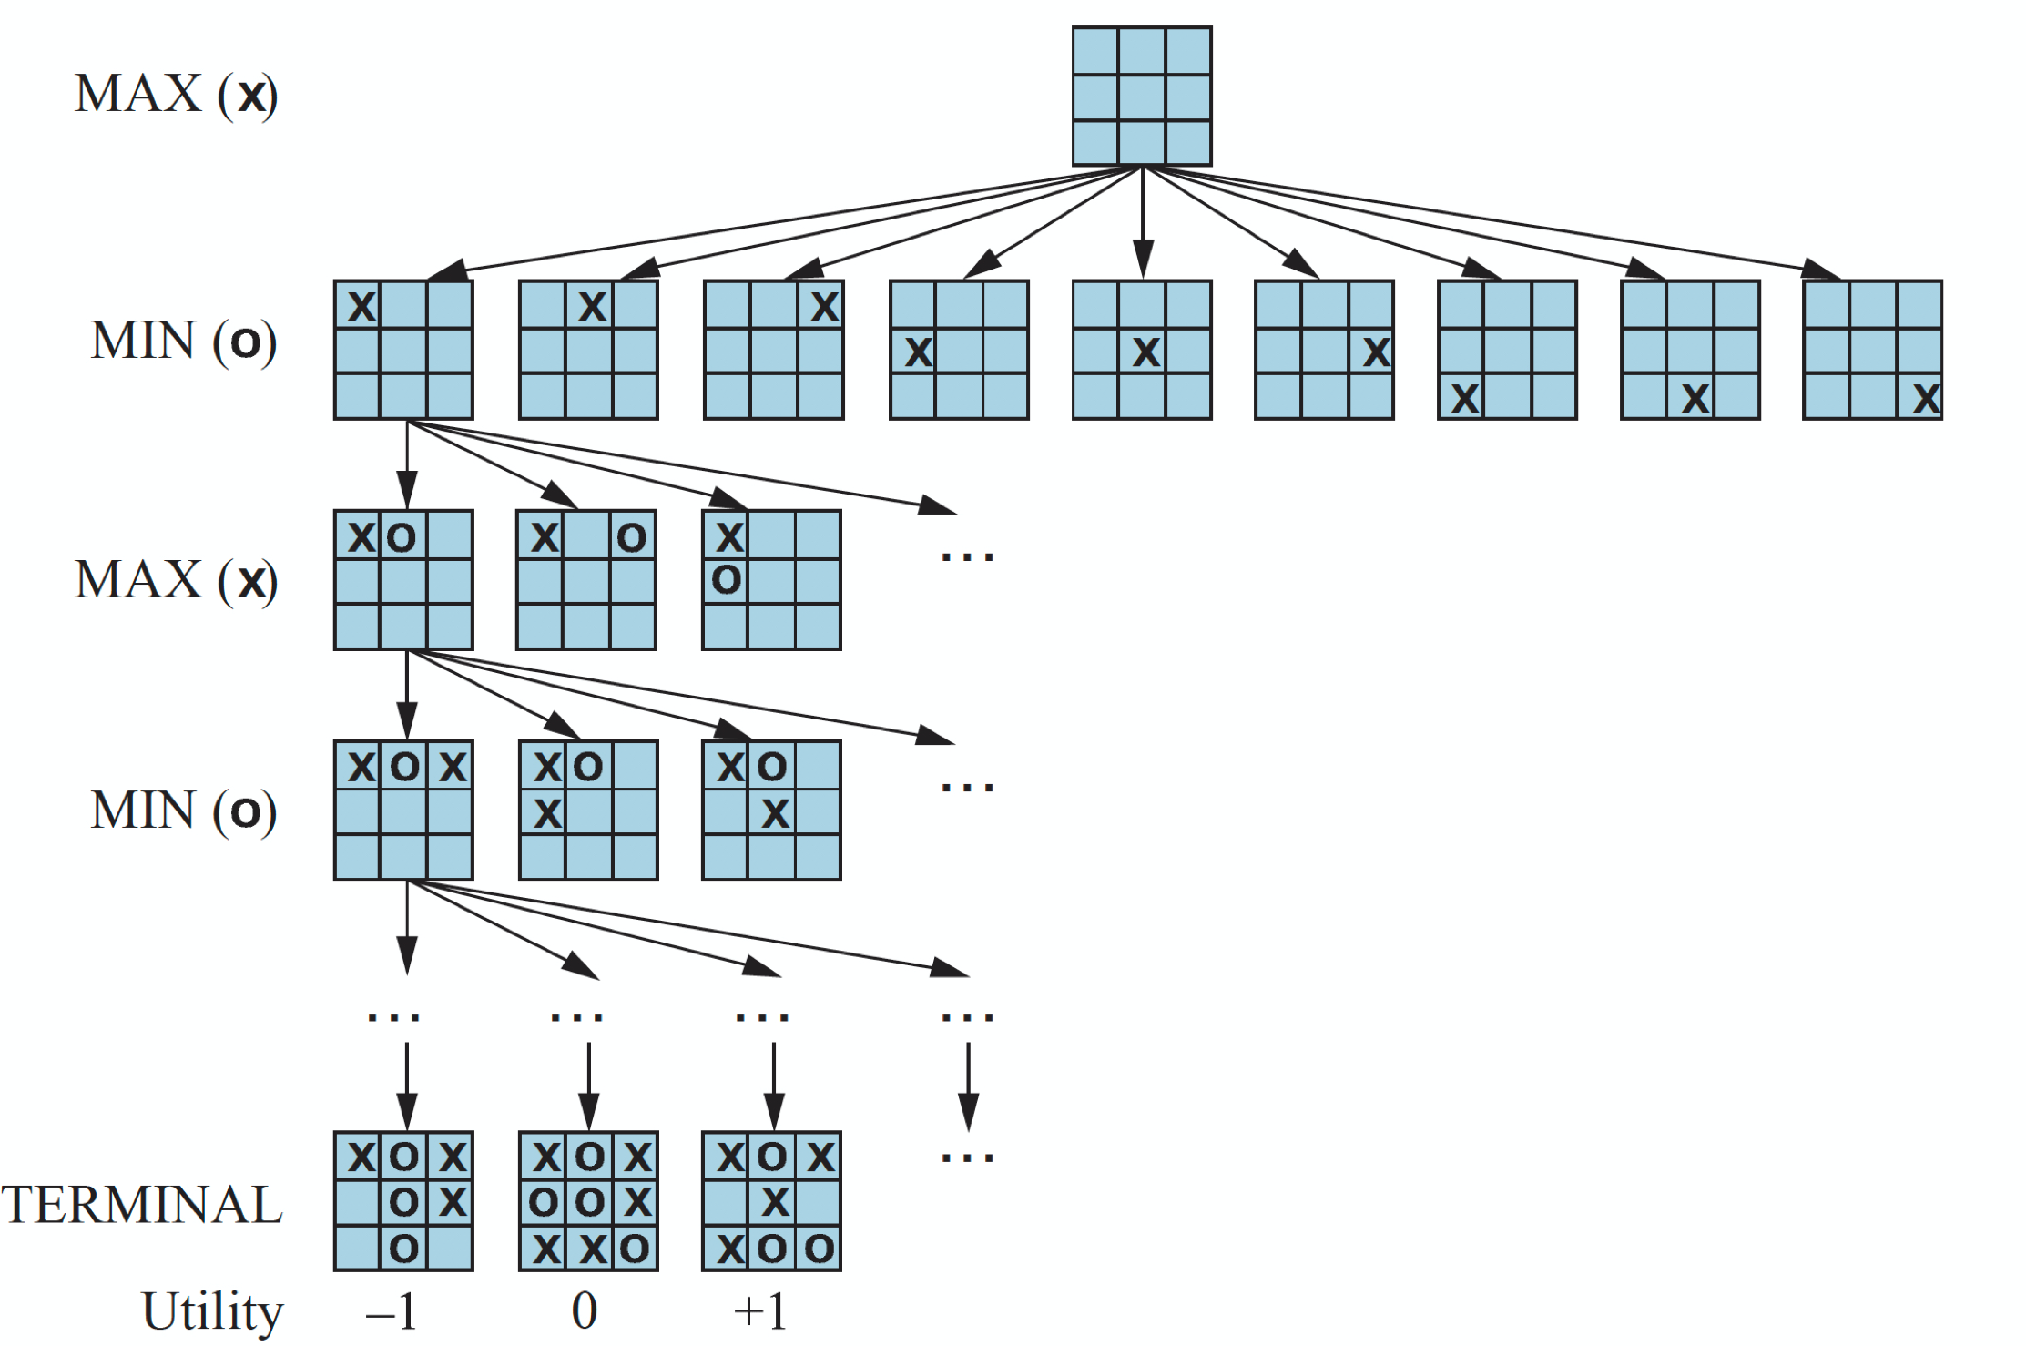
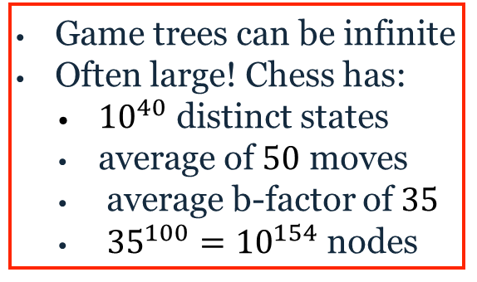
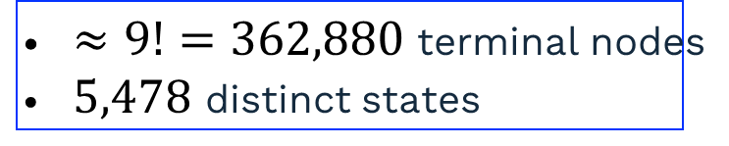
(Partial) Game Tree for Tic-Tac-Toe
2023-09-04
$≈9!=362,880$ terminal nodes
$5,478$ distinct states
Game trees can be infinite
Often large! Chess has:
${10}^{40}$ distinct states
average of $50$ moves
average b-factor of $35$
${35}^{100}={10}^{154}$ nodes

Slide 47
Optimal Decisions in Games: Minimax Search
2023-09-04
Generate the complete game tree using depth-first search.
Apply the utility function to each terminal state.
Beginning with the terminal states, determine the utility of the predecessor nodes (parent nodes) as follows:
Node is a MIN-node Value is the minimum of the successor nodes
Node is a MAX-node Value is the maximum of the successor nodes
From the initial state (root of the game tree), MAX chooses the move that leads to the highest value (minimax decision).
Note: Minimax assumes that MIN plays perfectly. Every weakness (i.e. every mistake MIN makes) can only improve the result for MAX.

Slide 48
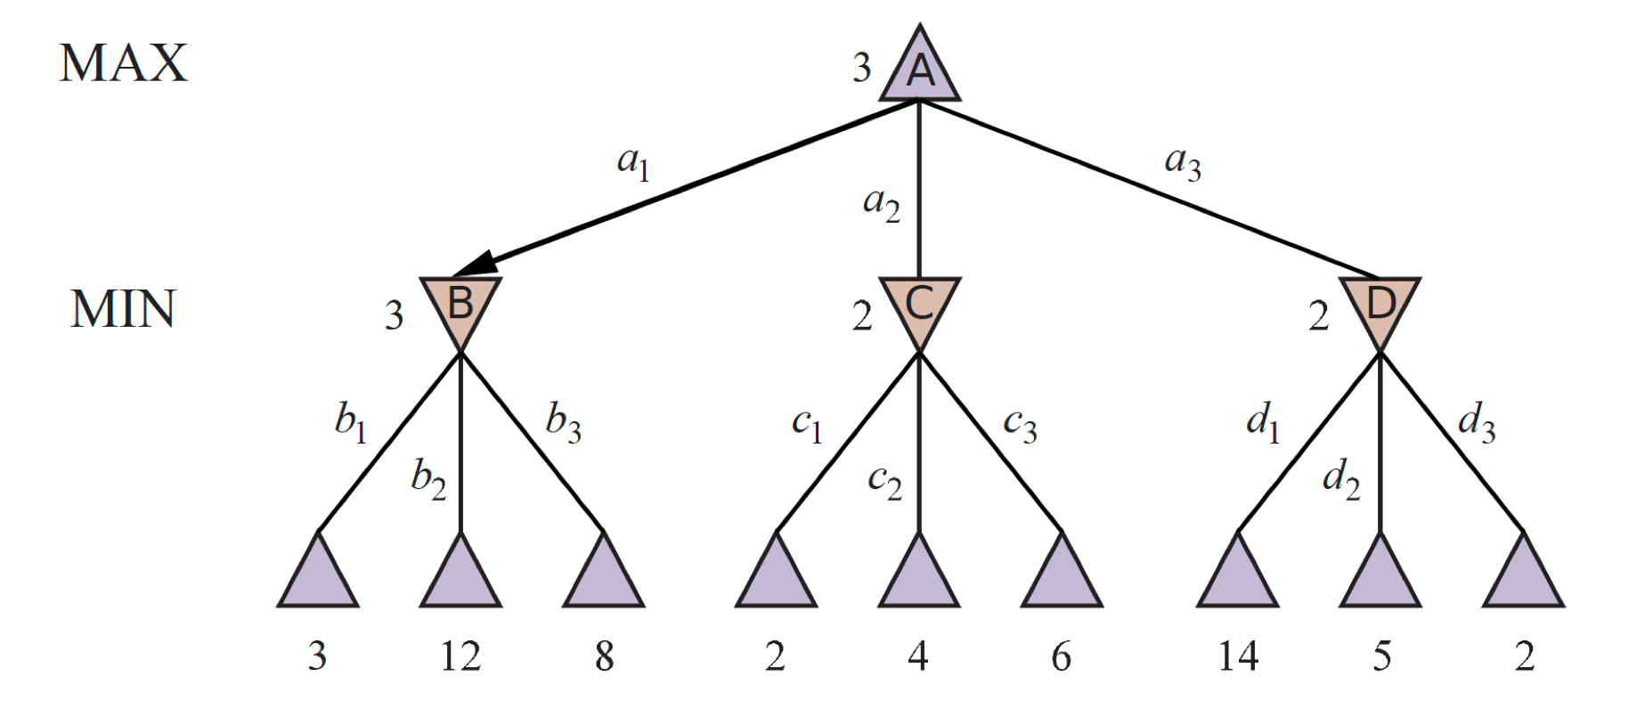
Minimax Tree
Interpreted from MAX’s perspective
Assumption is that MIN plays optimally
The minimax value of a node is the utility for MAX
MAX prefers to move to a state of maximum value and MIN prefers minimum value
What move should MAX make from the Initial state?

Slide 49
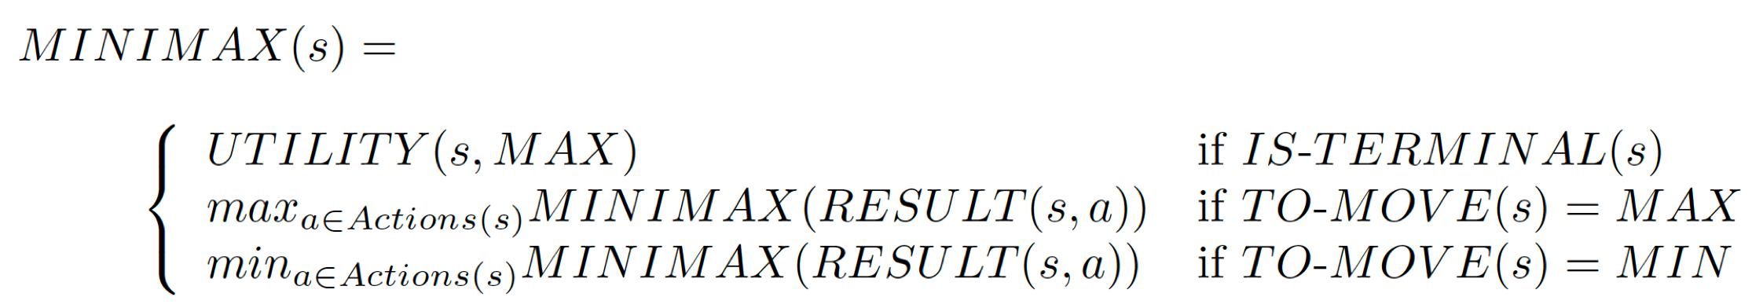
MAX utility values

Slide 50
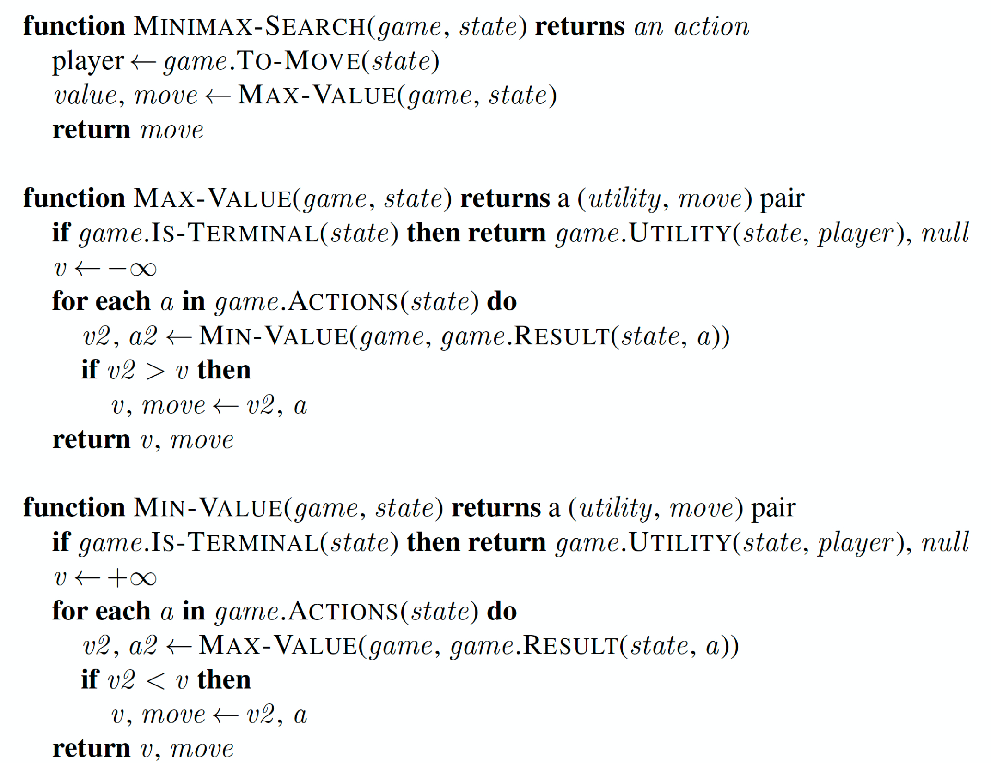
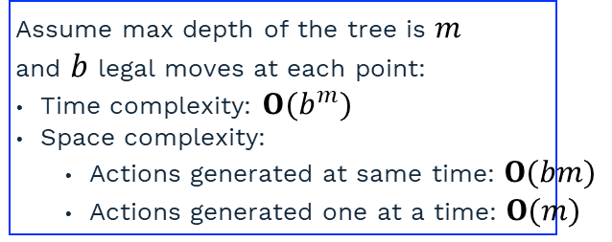
Minimax Algortihm
Assume max depth of the tree is $m$
and $b$ legal moves at each point:
Time complexity: $O(b^{m})$
Space complexity:
Actions generated at same time: $O(bm)$
Actions generated one at a time: $O(m)$
Serves as a basis for mathematical analysis
of games and development of approximations to the minimax algorithm
Recursive algorithm that proceeds all the way down to the
leaves of the tree and then backs up the minimax values
through the tree as the recursion unwinds

Slide 51
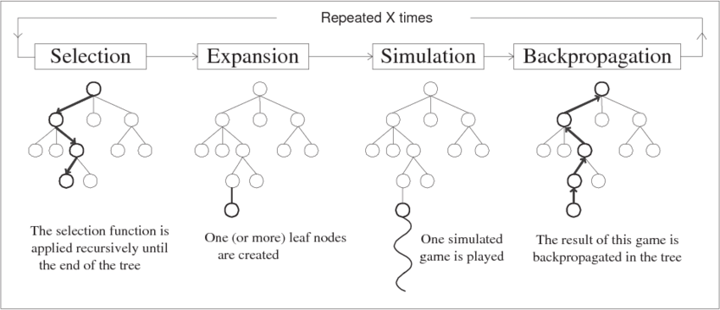
4 Steps in MCTS
2023-09-04
MCTS maintains a search tree and grows it on each iteration using the following steps:
Starting at the root of the search tree, choose a move using the
selection policy, repeating the
process until a leaf node is reached
Grow the search tree
by generating a new
child/children.
Perform a playout
from a child using
the playout policy. These
moves are not recorded
in the search tree
Use the simulation result
to update the utilities of
the nodes going back
up to the root.
After X times: Choose the best move from start state
TDDC17 - HT23 - Fredrik Heintz - LE3 Search II (based on slides by Patrick Doherty)

